Slide 1

OpenAI API
Changing
Direction

Slide 2
Major Changes to the API to Facilitate Agentic Workflows

Slide 3
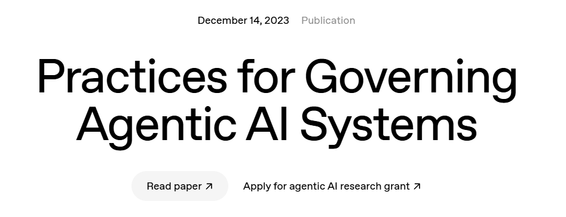
Notes:
https://openai.com/index/practices-for-governing-agentic-ai-systems/

Slide 4
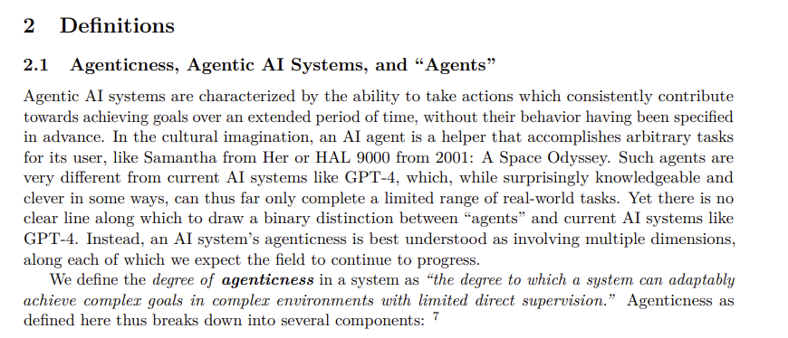
What is Agentic AI?
Notes:
https://cdn.openai.com/papers/practices-for-governing-agentic-ai-systems.pdf

Slide 5







Agent to Look at the Sky
Agent to Look Up the Weather Forecast
Is it going to rain today?
Routing / Gathering
Agent
Agent to Gather Local Sensor Data
Notes:
https://research.aimultiple.com/ai-agent-builders/

Slide 6
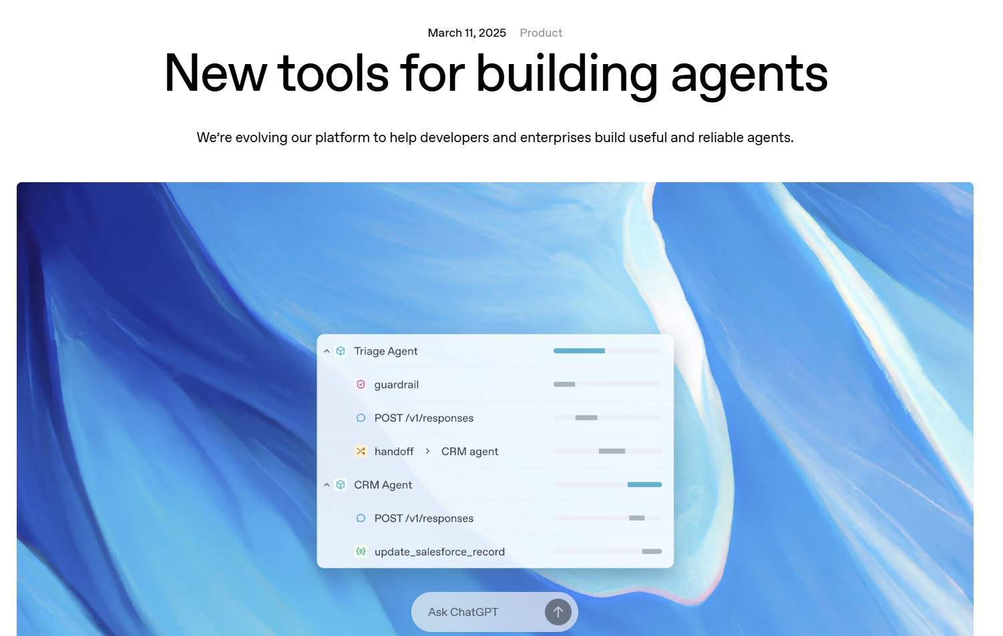
Notes:
https://openai.com/index/new-tools-for-building-agents/

Slide 7
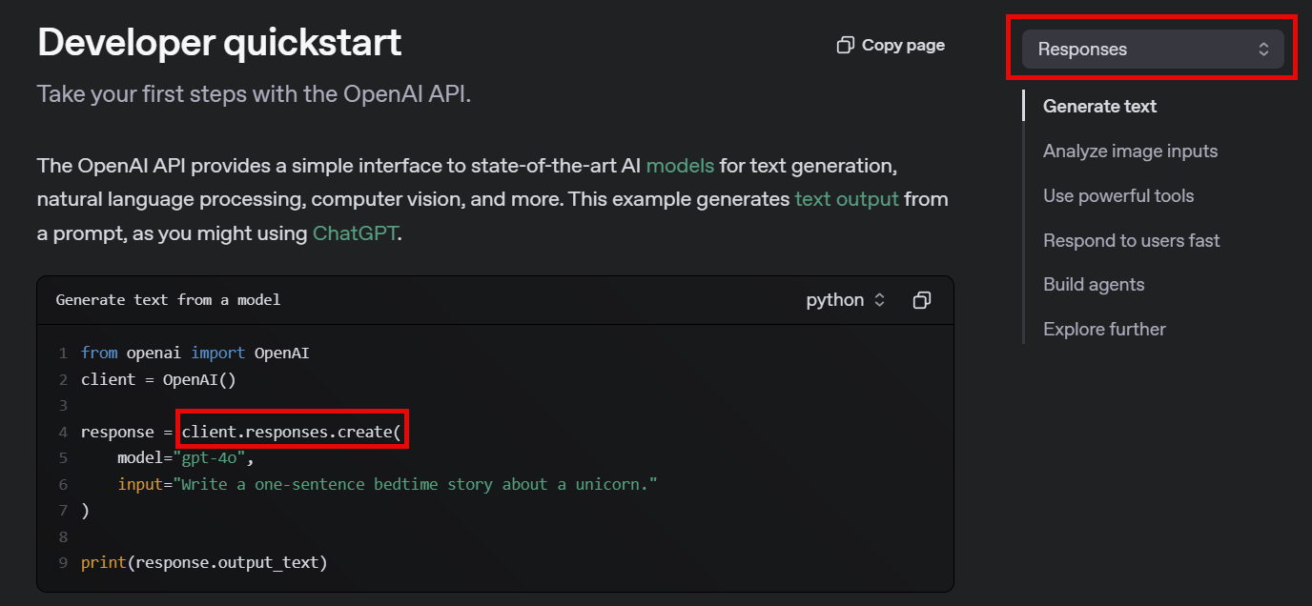
Notes:
https://platform.openai.com/docs/quickstart?api-mode=responses

Slide 8
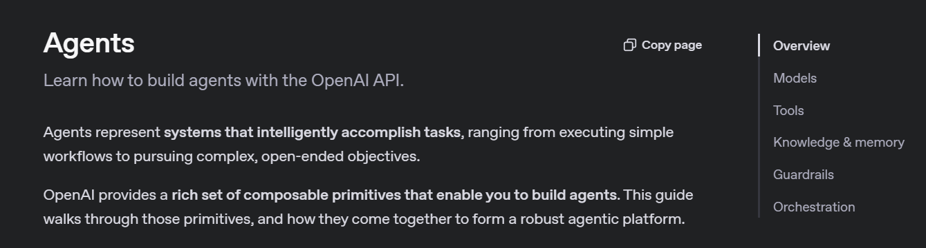
Notes:
https://platform.openai.com/docs/guides/agents

Slide 9
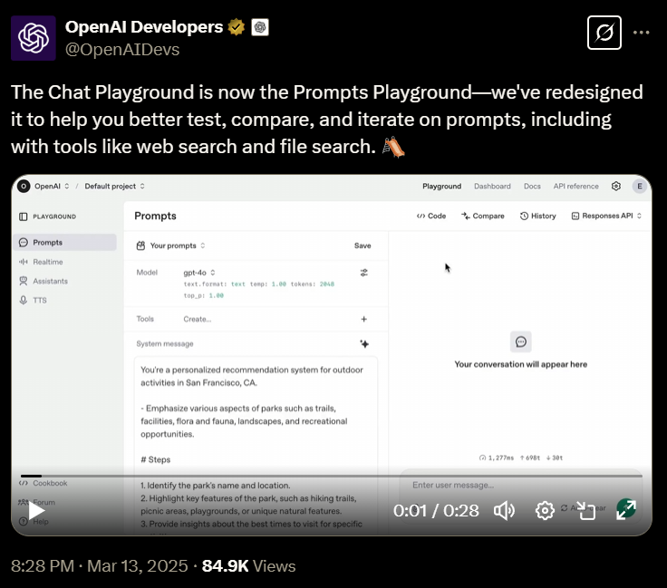
Notes:
https://x.com/OpenAIDevs/status/1900358343333482861

Slide 10




Notes:
https://www.youtube.com/channel/UC35ZpwldGw7ZJ5R-2sLijzw

Slide 11
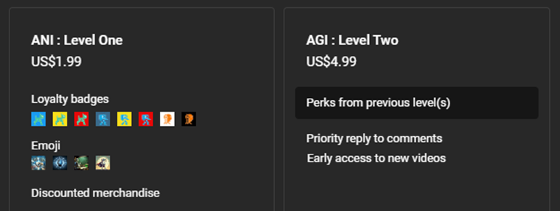

Notes:
https://www.youtube.com/@reallyeasyai/join

Slide 12

https://shop.reallyeasy.ai
Notes:
https://shop.reallyeasy.ai

Slide 13

https://www.youtube.com/@ainewsfresh
Notes:
https://www.youtube.com/@ainewsfresh

Slide 14

https://www.youtube.com/@aipaperspodcastdaily
Notes:
https://www.youtube.com/@aipaperspodcastdaily

Slide 15
The New Prompt Playground

Slide 16
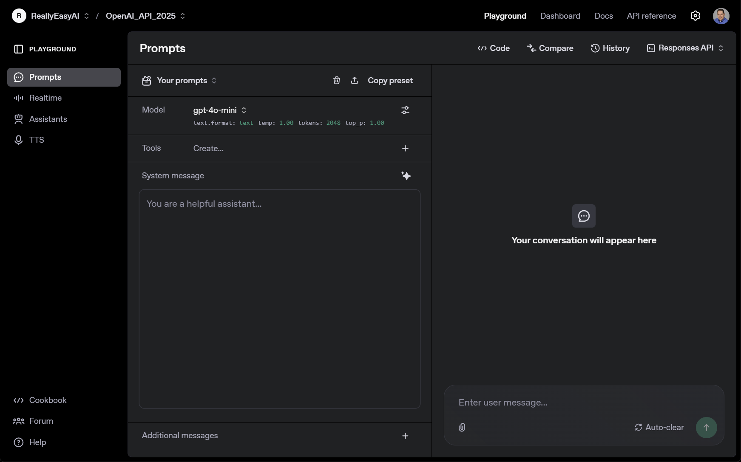
Notes:
https://platform.openai.com/playground/prompts?models=gpt-4o-mini

Slide 17
OpenAI API
Changing
Direction

